Slide 1

STATS 432 Computational Statistics
Tutorial 5 – Metropolis-Hastings Algorithm

Slide 2

Question 1

Slide 3


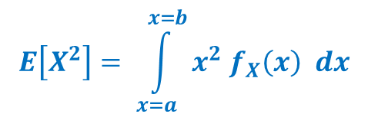
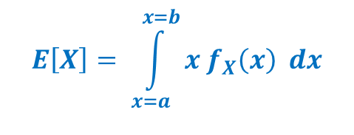
Question 1 :
Question 1
Consider the continuous random variable X defined by the following probability density function…
$$f_{X}\left(x\right) = \left\{\begin{matrix}\frac{30}{31} x^{2} {\left(1 −x\right)}^{2} & if & x∈[1,2] \\ 0 & if & x∉[1,2]\end{matrix}\right.$$
Analytically calculate the value of $E\left[X\right], E[X^{2}]$ and $Var\left[X\right].$ The following formulas will help you
$$E\left[X\right]= \int_{x=a}^{x=b}{x f_{X}\left(x\right) dx}$$
$$E\left[X^{2}\right]= \int_{x=a}^{x=b}{x^{2} f_{X}\left(x\right) dx}$$
$$Var\left[X\right]= E\left[X^{2}\right] −{\left( E\left[X\right] \right)}^{2}$$
3
Associated code = Tutorial 5 – Q1

Slide 4
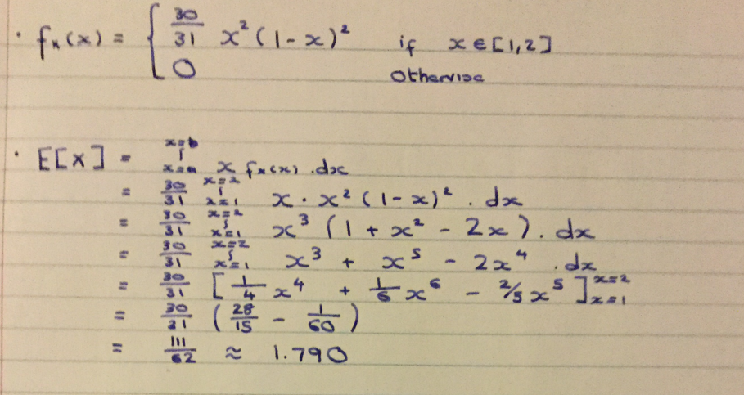
Question 1 :
Question 1
Calculation of $E\left[X\right]$
4
Associated code = Tutorial 5 – Q1

Slide 5
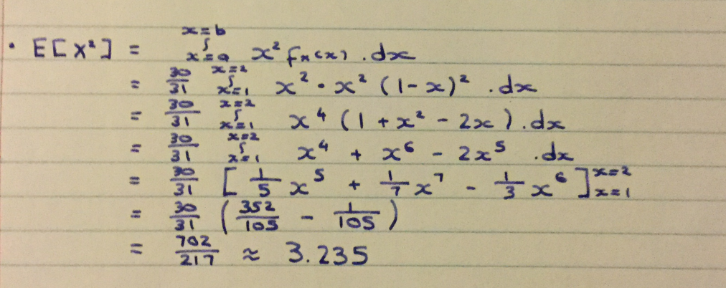
Question 1 :
Question 1
Calculation of $E\left[X^{2}\right]$
$$Var\left[X\right]= E\left[X^{2}\right] −{\left( E\left[X\right] \right)}^{2} = \frac{702}{217} − {\left(\frac{111}{62}\right)}^{2} ≈0.0298$$
5
Associated code = Tutorial 5 – Q1

Slide 6
Question 1 :
Question 1
Create a function in R which uses a normal random walk proposal density within the Metropolis-Hastings algorithm to produce a sequence of observations drawn from $f_{X}(x)$. Your function must have the following arguments…
MetHat <- function( n, start, proposal_sd)
… where ‘n’ is the number of observations to be produced, ‘start’ is the starting value of the chain and ‘proposal_sd’ is the standard deviation of the normal proposal density
See Section 1 of the code
Run your algorithm with the following parameters….
burnin <- 1000 # Length of burn-in mcmc <- 9000 # Length of post-burn-in chain set.seed(12345) MH_Output <- MetHat( n = burnin + mcmc, start = 1.5, proposal_sd = 0.25)
See Section 2.1b of the code
Specify the acceptance rate of the algorithm.
See Section 2.1c of the code
Acceptance rate = 0.5062
6
Associated code = Tutorial 5 – Q1

Slide 7
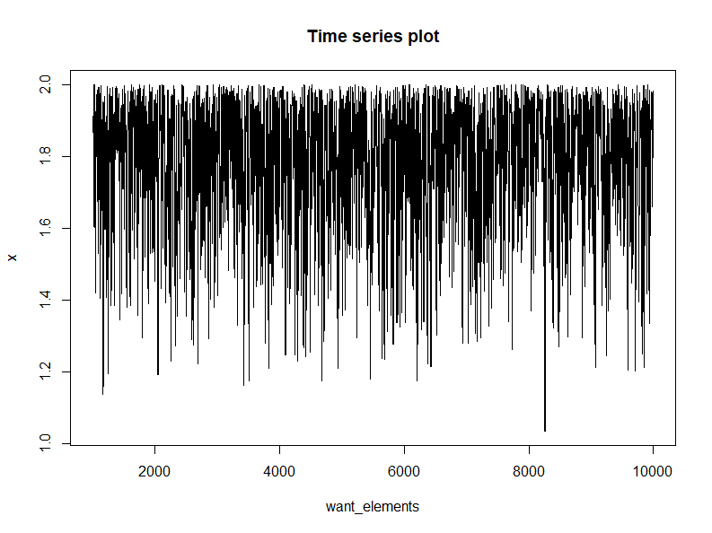
Question 1 :
Question 1
Create a time series plot of all elements in the chain AFTER the burn-in.
See Section 2.1d of the code
7
Associated code = Tutorial 5 – Q1

Slide 8
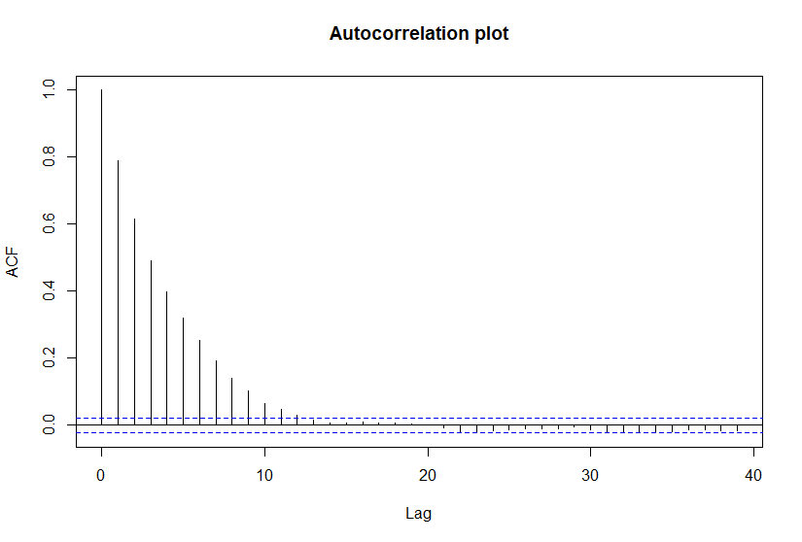
Question 1 :
Question 1
Create an autocorrelation plot of all elements in the chain AFTER the burn-in.
See Section 2.1e of the code
8
Associated code = Tutorial 5 – Q1

Slide 9

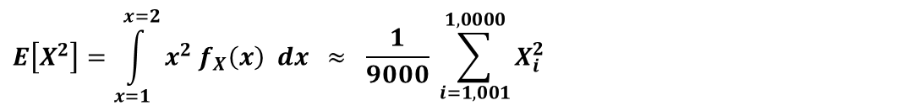
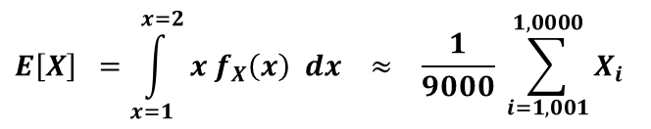

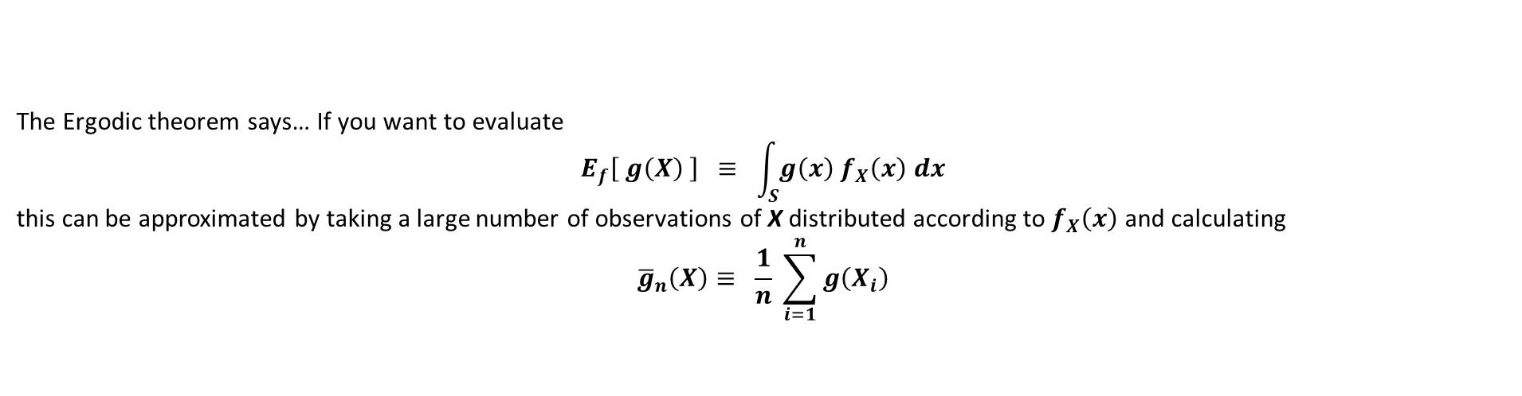

Question 1 :
Question 1
Use the post burn-in values of the chain to approximate $E\left[X\right], E[X^{2}]$ and $Var\left[X\right].$ Compare your results to the actual values calculated in part a).
The Ergodic theorem says… If you want to evaluate
$$E_{f}\left[ g\left(X\right) \right] ≡ \int_{S}{g\left(x\right) f_{X}\left(x\right) dx}$$
this can be approximated by taking a large number of observations of X distributed according to $f_{X}\left(x\right)$ and calculating
$${\overline{g}}_{n}\left(X\right)≡ \frac{1}{n} \sum_{i=1}^{n}{g\left(X_{i}\right)}$$
The sequence of observations ${\left\{X_{i}\right\}}_{i=1,001}^{10,000}$ constructed in our Metropolis-Hastings algorithm are distributed according to $f_{X}(x)$.
Therefore, $E\left[X\right], E\left[X^{2}\right]$ and $Var[X]$ can be approximated as follows…
$$E\left[X\right] =\int_{x=1}^{x=2}{x f_{X}\left(x\right) dx} ≈ \frac{1}{9000} \sum_{i=1,001}^{1,0000}{X_{i}}$$
$$=1.789856$$
$$E\left[X^{2}\right]=\int_{x=1}^{x=2}{x^{2} f_{X}\left(x\right) dx} ≈ \frac{1}{9000} \sum_{i=1,001}^{1,0000}{X_{i}^{2}}$$
These values are very close to the true values calculated analytically in part a).
$$=3.234712$$
See Section 3 of the code
$$Var\left[X\right]= E\left[X^{2}\right] −{\left( E\left[X\right] \right)}^{2}$$
$$=3.234712 −1.789856^{2} = 0.03112756$$
9
Associated code = Tutorial 5 – Q1

Slide 10
Question 2

Slide 11

Question 2 :
Question 2
Save the code you produced for Question 1 as a new (differently named) R file.
Create a function in R which uses a uniform independence sampler within the Metropolis-Hastings algorithm to produce a sequence of observations drawn from $f_{X}(x)$. Your function must have the following arguments…
MetHat1 <- function( n, start)
… where ‘n’ is the number of observations to be produced and ‘start’ is the starting value of the chain.
Run your algorithm with the following parameters….
burnin <- 1000 # Length of burn-in mcmc <- 9000 # Length of post-burn-in chain set.seed(12345) MH_Output <- MetHat1( n = burnin + mcmc, start = 1.5)
Use the post burn-in values of the chain to approximate the integral $\frac{30}{31}\int_{x=1}^{x=2}{ln(\sqrt{x}) x^{2} {\left(1 −x\right)}^{2}dx}$
11
Associated code = Tutorial 5 – Q2

Slide 12


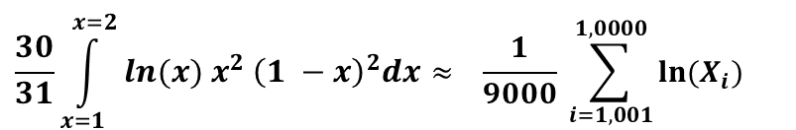
Question 2 :
Question 2
In order to answer parts a) – c) all we need to do is change Section 1.1c1 of the code
From
y <- rnorm(1, mean=x[i-1], sd=proposal_sd))
Normal Random Walk Sampler
To
y <- 1 + runif(1)
Uniform Independence Sampler
In order to answer part d)… The Ergodic theorem says that if you want to evaluate the integral
$$E_{f}\left[ g\left(X\right) \right] ≡ \int_{S}{g\left(x\right) f_{X}\left(x\right) dx}$$
this can be approximated by taking a large number of observations of X distributed according to $f_{X}\left(x\right)$ and calculating
$${\overline{g}}_{n}\left(X\right)≡ \frac{1}{n} \sum_{i=1}^{n}{g\left(X_{i}\right)}$$
The sequence of observations ${\left\{X_{i}\right\}}_{i=1,001}^{10,000}$ constructed in our Metropolis-Hastings algorithm are distributed according to $f_{X}(x)$.
Therefore, the desired integral can be approximated as…
$$\frac{30}{31}\int_{x=1}^{x=2}{ln(x) x^{2} {\left(1 −x\right)}^{2}dx}≈ \frac{1}{9000} \sum_{i=1,001}^{1,0000}{{ln⁡(X}_{i}})$$
$$=0.2887181$$
Wolfram Alpha evaluates this integral as 0.28867
12
Associated code = Tutorial 5 – Q2

